Slide 1
MongoDB
Sahana Visarla

Slide 2
01
02
03
NoSQL Database
MongoDB
Execution
Usage of NoSQL and available databases
Why MongoDB and advantages of usage
Sample Database Creation

Slide 3
01
NoSQL Database

Slide 4
NoSQL Database
What is a NoSQL Database?
Store and retrieve structured, semi-structured, unstructured and polymorphic data
What are the uses of NoSQL Databases?
Horizontal Scalability
High Performance
Handle unstructured data

Slide 5
NoSQL Database
Key Value database
Document database
Graph database
Column-oriented database
What are all the NoSQL databases?

Slide 6
02
Analyze MongoDB

Slide 7
Analyze MongoDB
What is MongoDB?
Developers can store, manage, and retrieve data and is compatible with most programming languages
Why is MongoDB used?
Sharding
Replication
Aggregation Framework
Cloud Computing

Slide 8
Analyze MongoDB
High Performance
Query API
High Availability
Horizontal Scalability
Support for Multiple Storage Engines
What are the advantages of MongoDB?

Slide 9
03
Execution

Slide 10

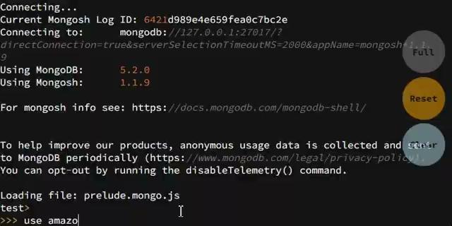
Use Database and Insert Collections

Slide 11
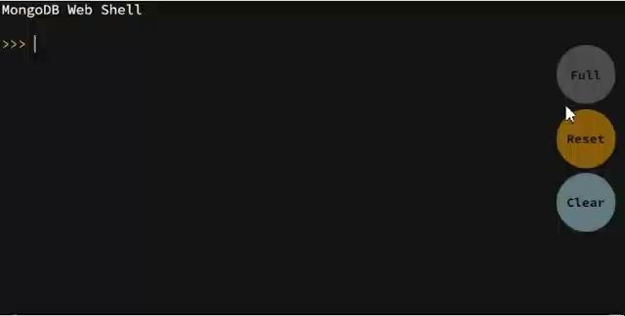
Find Collections

Slide 12
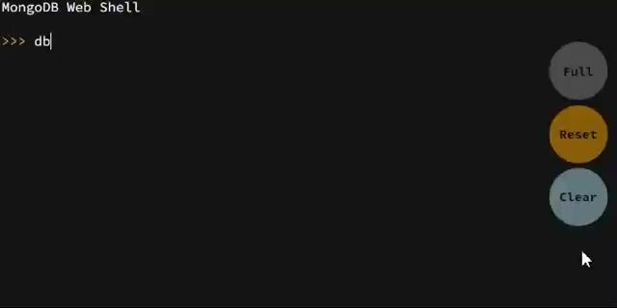
Filter Data

Slide 13
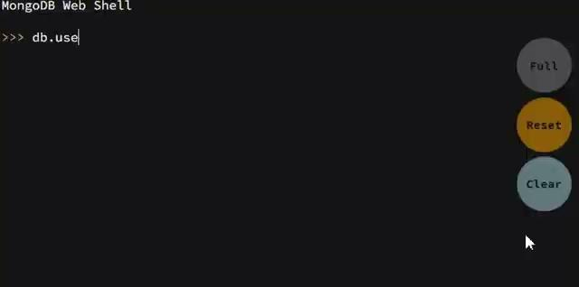
Project Fields

Slide 14
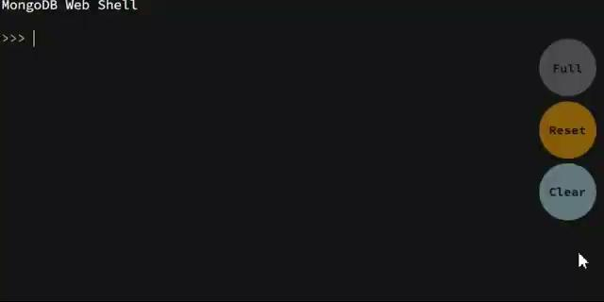
Aggregate

Slide 15
Thank You

